Slide 1


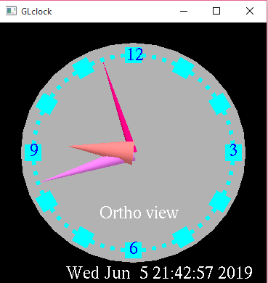
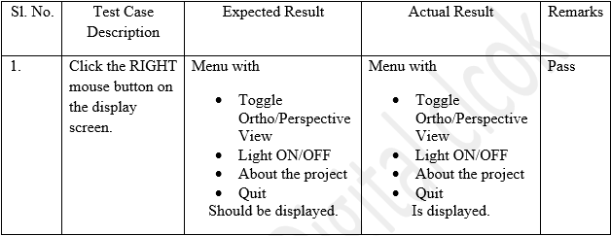
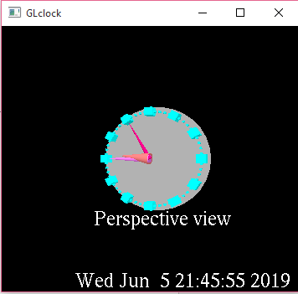
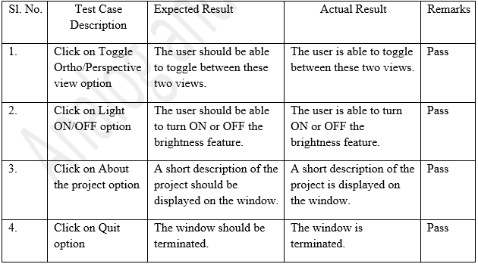
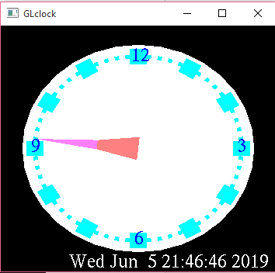
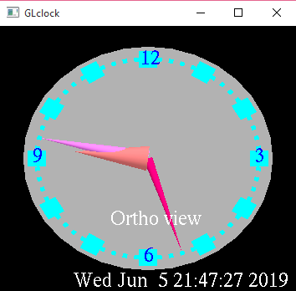
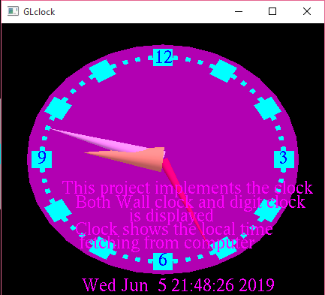
Analog and Digital Clock Using OpenGL
Dahit Santosh, Nur Alam MD, Department of Smart
Computing, Kyungdong University, Republic of Korea.
Introduction
A clock is an instrument used to measure, keep, and indicate time or a clock is any free-standing device or instrument for measuring or displaying the current time. The clock is one of the oldest human inventions, meeting the need to measure intervals of time shorter than the natural units: the day, the lunar, month, and the year.
Computer Graphics is concerned with all aspects of producing pictures or images using a computer. We can create images that are indistinguishable from photographs of real objects. In other terms, Computer Graphics are the graphics created by the computers, and more generally, the representation and manipulation of image data by a computer.
In this paper, the proposed project computer graphics project is in OPENGL using C programing language . A simple analog clock having circular shape with hour, minute and second gear. Digital time is also shown in bottom of that analog clock. This clock shows the real or local time that is having in current computer.
The ‘localtime (&ltime)' function is used to get the local time. With proper mathematics and conversion of the time for sec, min and hours the graphical hands are made to make movement. The user can toggle between two types of views and can enable or disable the background brightness of the clock.
Output and snapshots of each functions:
  Initial View:
  B. Perspective view:
  C. Light ON:
D. Light Off:
E. Description about the project
  F. Testing:
  Testing for mouse
Testing for Menu:
G. Discussion:
The proposed project is based on OPENGL program using c programing language. There are many functions and steps used to make this projects:
Header file
Define objects
Creating object
Adding colour on object, making position of object
Adding View state
Adding Lighting effects
The snapshot above shows the Clock in Ortho view initially.
The snapshot above shows the Clock in perspective view. The user is able to toggle between these two views.
Aim
The main of this project are as follows:
To show real time in analog mode
To show time in digital mode to make easy.
Showing date and name of days which makes easier than having calendar.
Making difference in ortho and perspective view in object.
Adding lighting effect
Methods: Using Header files, functions and Instructions
Header Files:
Functions used:
Instruction:
Right click on the opened window.There are options to handle the object like as description about the projects, ortho or perspective view, lights on or off and exits.
      About the project
      Ortho or perspective view
      Light Off/On
      Exits
The snapshot above shows the Clock with brightness on.
#include <GL/glut.h>
#include <string.h>
#include <stdio.h>
#include <stdlib.h>
#include <math.h>
#include <time.h>
#define M_TWOPI 3.14159265358979323846264
Conclusion
This mini project on CLOCK using OpenGL is a reliable graphics package that provides the user with the basic working of an analog as well as a digital clock. It provides the user with certain other operations like toggling between two different kinds of views, adjusting the brightness by turning the lights on or off, also allows the user to read a short description of what the project is about. The user-friendly interface allows the user to interact with it very effectively.
glutIdleFunc()
glutDisplayFunc()
glutMainLoop()
glViewport()
glVertex3fv()
glColor3fv()
glFlush()
glutPostRedisplay()
glMatrixMode()
glLoadIdentity()
glTranslatef() :
glutInit()
glutInitDisplayMode()
glutInit()
glutInitDisplayMode()
glutCreateWindow()
glutInitWindowSize()
glutInitWindowPosition()
glutKeyboardFunc()
glutSpecialFunc()
glutReshapeFunc()
glRotatef()
The snapshot above shows the Clock with brightness off. The user is able to adjust the brightness of the clock.
Acknowledgements
This study was carried out with the academic project under computer graphics, Department of Smart Computing, Kyungdong University (KDU), Republic of Korea.
The snapshot above shows a short description about the project.

